Slide 1

Reinforced Negative Sampling for Recommendation with Exposure Data
Jingtao Ding¹, Yuhan Quan¹, Xiangnan He², Yong Li¹, Depeng Jin¹
¹ Tsinghua University ² University of Science and Technology of China
Notes:
Good morning everyone! I’m Jingtao Ding from Tsinghua University. I’m going to present our work on improving the XX. This is our joint work with USTC.

Slide 2
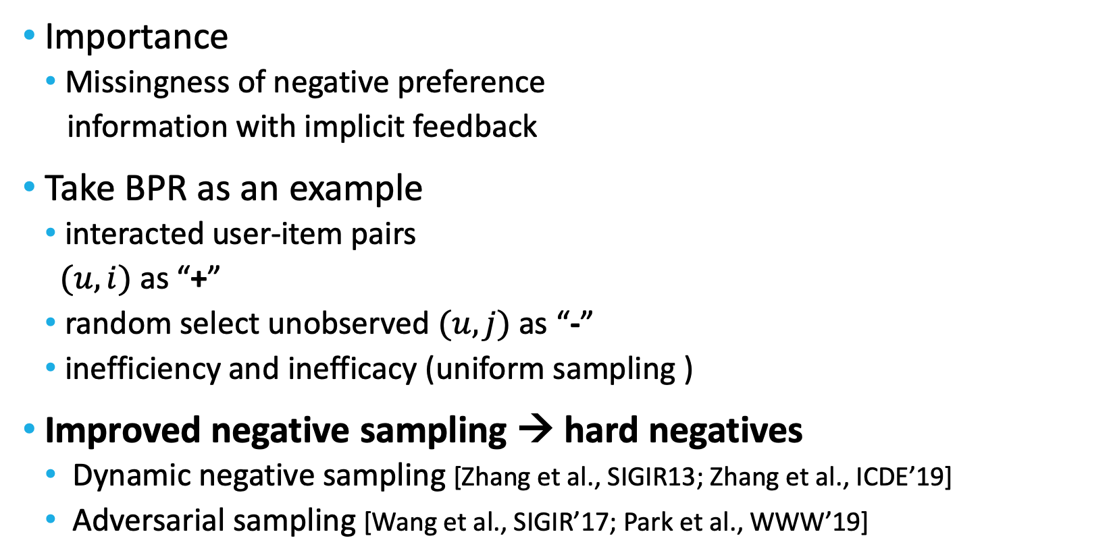
Negative Sampling in Recommender Systems
Importance
Missingness of negative preference
information with implicit feedback
Take BPR as an example
interacted user-item pairs
$(u,i)$ as “+”
random select unobserved $(u,j)$ as “-”
inefficiency and inefficacy (uniform sampling )
Improved negative sampling → hard negatives
Dynamic negative sampling [Zhang et al., SIGIR13; Zhang et al., ICDE’19]
Adversarial sampling [Wang et al., SIGIR’17; Park et al., WWW’19]
[Rendle et al, UAI’09]
MAX margin

Slide 3
Motivation
Comparing different negative sampling strategies
Random
sampling
Popularity-based
sampling
Accuracy
Hard negative
sampling
Informativeness
Sampling hard negatives is informative but may be inaccurate due to false negatives

Slide 4
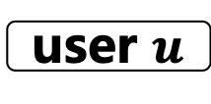
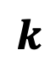
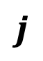
Motivation
Exposure
Exposure data
Whether the recommended (i.e., exposed) item has been interacted by a user
Rec. Sys.
Item
User
Interact or not
Exposure data provide more reliable information about the negative preference of users
Hard & Real negative instances
Generated negative
user $u$
…
$$j$$
Target: generate high-quality negative instances for better recommenders.
…
$$k$$
Unobserved
instances
Exposed but not interacted

Slide 5
Reinforced Negative Sampler (RNS)
Generated Negative

Slide 6
Reinforced Negative Sampler (RNS)
Reward
Negative sample
Adversarial sampler (AS)
Maximize following reward:
→ hard negatives

Slide 7
Reinforced Negative Sampler (RNS)
Exposure-matching sampler (ES)
Challenge 1
Incompleteness of negative preference in exposure data
Random
sampling
Ideal negative samples
Accuracy
Popularity-based
sampling
Direct sampling from exposure data
Selection bias
Hard negative sampling
Informativeness

Slide 8
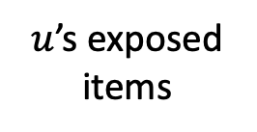
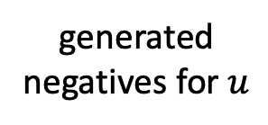
Reinforced Negative Sampler (RNS)
Exposure-matching sampler (ES)
Generate real negatives according to exposure data
$u$’s exposed items
generated negatives for $u$
Maximize the overlap
shortcomings:
a simple scalar reward for the whole batch
non-informative, selection bias

Slide 9
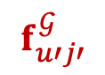
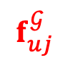
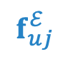
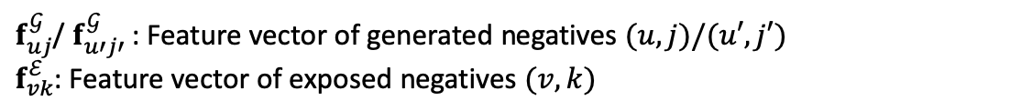
Reinforced Negative Sampler (RNS)
Exposure-matching sampler (ES)
Feature-matching scheme
Improve reward informativeness
Discrete Item ID → Distribution of latent features
MMD (Maximum Mean Discrepancy) based reward
dist. between {generated neg.} and {exposed neg.}
Generated
instances
Exposed
instances
x
$$f_{uj}^{ℰ}$$
$f_{uj}^{𝒢}$/ $f_{u′j′}^{𝒢}$: Feature vector of generated negatives $(u,j)/(u′,j′)$
$f_{vk}^{ℰ}$: Feature vector of exposed negatives $(v,k)$
$$f_{u′j′}^{𝒢}$$
$$f_{uj}^{𝒢}$$
Unobserved
instances
Generate exposure-like negatives from unobserved data
alleviate the selection bias

Slide 10
Reinforced Negative Sampler (RNS)
Learning the adversarial and exposure-matching sampler
Challenge 2
Difﬁculty of optimizing the RNS
Non-differentiable objective
Discrete item space
Sampler generates negatives to train Recommender
iteratively
Sampler is updated by receiving rewards from Recommender
policy gradient based RL
A general learning framework for integrating signal from both hard negative and exposure data

Slide 11
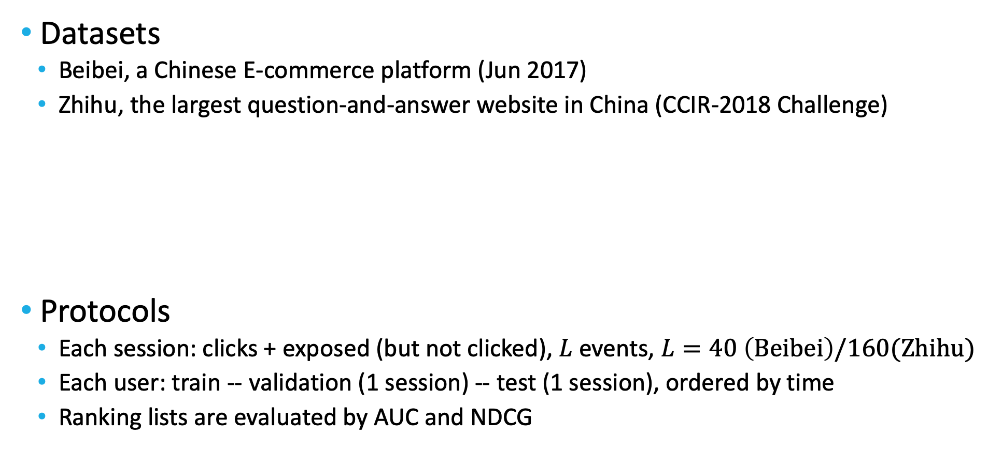
Experimental Settings
Datasets
Beibei, a Chinese E-commerce platform (Jun 2017)
Zhihu, the largest question-and-answer website in China (CCIR-2018 Challenge)
Protocols
Each session: clicks + exposed (but not clicked), $L$ events, $L=40 \left(Beibei\right)/160(Zhihu)$
Each user: train -- validation (1 session) -- test (1 session), ordered by time
Ranking lists are evaluated by AUC and NDCG

Slide 12
Baselines
Common
ItemPop: Ranking items base on their popularity
BPR-GMF [Rendle et al., UAI’09]: Optimizing the MF-based model with a pairwise ranking loss
Adversarial sampling
BPR-DNS [Zhang et al., SIGIR’13]: Selecting the item with the highest prediction score as negatives
KBGAN [Cai and Wang, NAACL’18]: Generating adversarial samples as negatives
IRGAN [Wang et al., SIGIR’17]: GAN-based IR model
Exposure-enhanced sampling
BPR-EN: Selecting negatives only from exposure data
EBPR [Ding et al., WWW’18]: Selecting negatives from both exposure data and unobserved data

Slide 13
Performance Comparison
RNS Performs best among baselines
DNS > GAN-based (large item space)
BPR-EN performs poorly (selection bias)

Slide 14
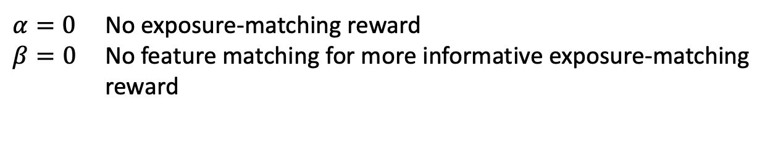
Ablation Study
Hard Negative v.s. Real Negative
Both adversarial sampler (AS) and exposure-matching (ES) helps
Real Negative > Hard Negative
$α=0$ No exposure-matching reward
$β=0$ No feature matching for more informative exposure-matching reward

Slide 15
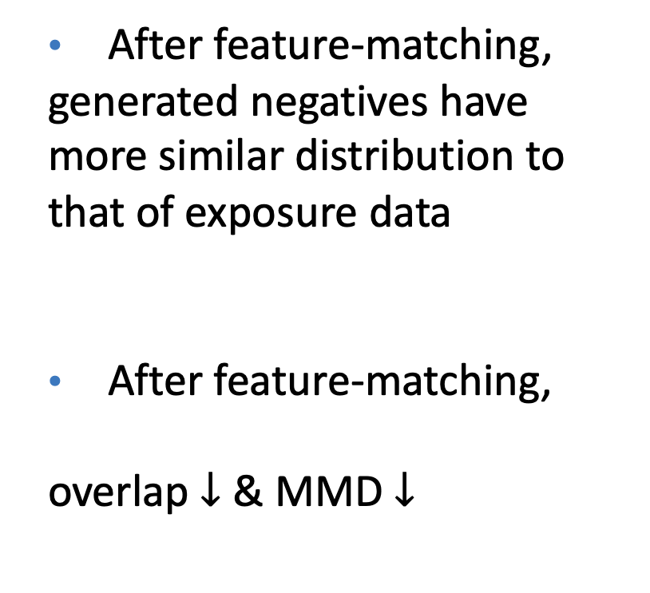
Impact of Feature Matching Scheme
After feature-matching,
generated negatives have more similar distribution to that of exposure data
After feature-matching,
overlap$↓$ & MMD $↓$
Before → After
2d t-SNE visualizations of the feature vectors

Slide 16
Conclusion & Future Work
Summary of contributions:
Learning to sample negative instances for recommendation
A RNS model that combines adversarial training and feature matching together, which is trained with RL method
Not only higher accuracy, but also the applicability to any recommender systems with negative sampling
Future Work
More fine-grained design of feature matching scheme when generating negatives
More general negative samplers for context-rich recommender systems
Notes:
To summarize

Slide 17
Reference
[Rendle et al., 2009] Steffen Rendle, Christoph Freudenthaler, Zeno Gantner, and Lars Schmidt-Thieme. Bpr: Bayesian personalized ranking from implicit feedback. In UAI, pages 452–461, 2009.
[Zhang et al., 2013] Weinan Zhang, Tianqi Chen, Jun Wang, and Yong Yu. Optimizing top-n collaborative ﬁltering via dynamic negative item sampling. In SIGIR, pages 785–788, 2013.
[Zhang et al., 2019] Yongqi Zhang, Quanming Yao, Yingxia Shao, and Lei Chen. Nscaching: Simple and efﬁcient negative sampling for knowledge graph embedding. In ICDE, pages 614–625, 2019.
[Wang et al., 2017] Jun Wang, Lantao Yu, Weinan Zhang, Yu Gong, Yinghui Xu, Benyou Wang, Peng Zhang, and Dell Zhang. Irgan: A minimax game for unifying generative and discriminative information retrieval models. In SIGIR, pages 515–524, 2017.
[Park and Chang, 2019] Dae Hoon Park and Yi Chang. Adversarial sampling and training for semi-supervised information retrieval. In WWW, pages 1443–1453, 2019.
[He et al., 2017] Xiangnan He, Lizi Liao, Hanwang Zhang, Liqiang Nie, Xia Hu, and Tat-Seng Chua. Neural collaborative filtering. In WWW, pages 173–182, 2017.
[Cai and Wang, 2018] Liwei Cai and William Yang Wang. Kbgan: Adversarial learning for knowledge graph embed-dings. In NAACL, pages 1470–1480, 2018.
[Ding et al., 2018] Jingtao Ding, Fuli Feng, Xiangnan He, Guanghui Yu, Yong Li, and Depeng Jin. An improved sampler for bayesian personalized ranking by leveraging view data. In WWW Companion, pages 13–14, 2018.

Slide 18
Thank you! I’m happy to take questions.
Codes: https://github.com/dingjingtao/ReinforceNS
dingjt15@mails.tsinghua.edu.cn
liyong07@tsinghua.edu.cn
FIB-LAB: http://fi.ee.tsinghua.edu.cn
Notes:
Thanks all

